Slide 1
Physics 123

Slide 2
Lecture 1

Slide 3
Introduction to the Course and

Slide 4
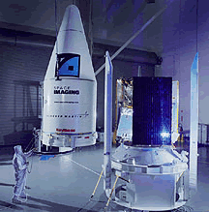

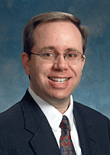
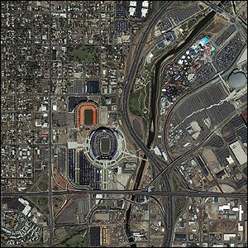

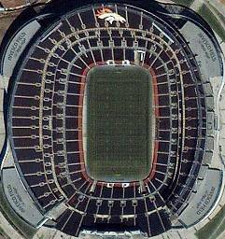
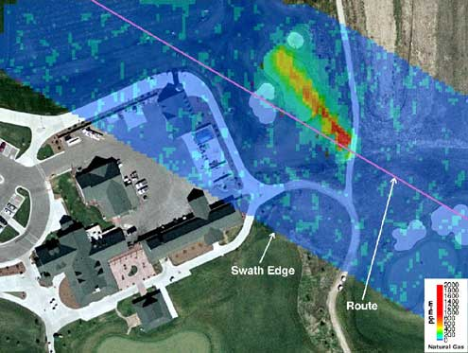
Instructor Introduction
R. Todd Lines
Education
  BS Physics – BYU
  MS, PhD Physics – NMSU
Recent Experience
  19 years at BYUI
  6 years with ITT (Eastman Kodak)
    Laser radar
    Atmospheric physics
    Remote sensing
  4 years experience with Raytheon
    Weather satellite design
  6 years experience with the US Army Research Laboratory
    Atmospheric physics
    Remote sensing

Slide 5
Instructor Introduction
I know, I don’t look like this anymore
R. Todd Lines
Education
  BS Physics – BYU
  MS, PhD Physics – NMSU
Recent Experience
  19 years at BYUI
  6 years with ITT (Eastman Kodak)
    Laser radar
    Atmospheric physics
    Remote sensing
  4 years experience with Raytheon
    Weather satellite design
  6 years experience with the US Army Research Laboratory
    Atmospheric physics
    Remote sensing

Slide 6
Survey Results

Slide 7

READ YOUR EMAIL!

Slide 8
Survey Results:
What do you hope to learn from this course?
  Most people said they want to learn the principles of physics.
  One student said he would like to learn some problem solving skills that will be useful in Physics and Engineering
  No one said they wanted to learn English Grammer
    This is comforting.
What do you hope to do with this new knowledge?
  Most said they wanted to apply what they learn in their field—to be successful in their jobs
  We have many engineers and a few scientists. Electrical engineers and Geologists especially need the wave motion part.
What I hope to learn from this course is a stronger understanding of the principles taught in Physics 223, especially in a way that helps me not just solve problems, but actually understand what is happening physically.

Slide 9
Survey Results
What do you expect the lectures to do for you?
  Most wanted the lectures to answer questions and clarify concepts
    This is in keeping with the Learning Model
  Some wanted all the material to be taught in the lectures. This was especially true for those with reading issues. If you are in this boat, come talk to me and I can suggest some additional video lectures.
  I will do the best I can to split this difference. I will try to emphasize concepts in lectures (but there will be examples) and emphasize computation on the “Exam Prep” days.
I expect the lectures to teach me the concepts I am supposed to learn and teach me how to solve problems that relate to the concepts I am learning.

Slide 10
Survey Results
What do you expect the book to do for you?
  Answers varied
    Some said it would be a source for deep learning
    Most said it would be a resource
    Some said it is where they do their primary learning
Studies in 1990’s showed that in introductory physics courses…”
  30% of students read the book
  30% of students pass the course
The studies showed that the book is most helpful if read in advance of lecture and homework
  Think of an English class, could you discuss and understand Hamlet without reading it?
Current studies say online books are harder to learn from >sigh< so you will need to work harder to read the book we have chosen. There is a paper version of the book available.
I expect the textbook to give me a first exposure to the content. I don't always absorb that much from just reading some dry material, so I try to find a way to make it more interactive using AI or other tools to teach me and "dumb it down" to my level.

Slide 11
Survey Results
How many hours a week do you think it will take to learn all you need to know from this course?
  Answers varied from 7 to 15.
  Most answered around 15
  I hope that it will be no more than 12
  We meet 5 days a week and you expect two hours out of class for every hour in class = 15 hours, so it could be 15
  It takes time and effort to grow new neurological connections that support these new skills
If it feels like you are spending too much time in this class come see me. Chances are we can apply good strategies to speed you up.
11

Slide 12
Course Description
This course is the second semester of the Principles of Physics sequence.
The course is designed for students majoring in physics, engineering, chemistry, and mathematics.
The course covers topics in waves, thermodynamics, and optics. These areas of study are important in almost all areas of engineering and in all scientific disciplines.
  For example, understanding wave properties is essential in construction (civil, mechanical engineering) to avoid unwanted and destructive resonances, wireless communication (electrical engineering), remote sensing (engineering, physics) and many other fields.
  Thermodynamics has application in engine design, heat transfer, earth energy balance, and many other important and exciting areas of current research.
  Finally, the principles of optics are involved in fiber-optic communications, fiber laser design, instrument design, remote sensing and surveillance system design, etc.

Slide 13
Course Objectives
The primary objective of this course is to help you develop a conceptual understanding of the fundamental physical principles described above.
The second objective of this course is for you to develop the mathematical description of these principles that can then be used to develop devices, structures, and technologies that are useful for mankind.
The third objective of the course is to help you use the mathematical description of these principles to develop problem solving skills that will benefit your future career.

Slide 14
General Philosophy of the Course
Physics is a topic that must be learned by faith, that is, by action.
  You will need to read the text and perform the homework assignments in order to succeed in this course.
    Studies have indicated there is value of reading the text but principally if the text is read before the lecture
  Makes the semester less frustrating, more enjoyable
And see that all these things are done in wisdom and order; for it is not requisite that a man should run faster than he has strength (Mosiah 4:27)

Slide 15
Building Brain is a Biological Process!
Plan to be in class and do the homework like you would be in the gym and do the exercising if you wanted to build muscle.
Proper sleep and nutrition are really important
If it starts to feel like this class is too much to lift – Come see me!

Slide 16
Learning Model Implementation
Teach One Another
Class Discussion
Prepare
Reading Assignment
Ponder/Prove
Daily Quiz, homework

Slide 17
Learning Model Implementation
Discuss
Discuss
Discuss
Read
Read
Read
Exam
Quiz
Quiz
Quiz

Slide 18
Learning Model Implementation
Final

Slide 19

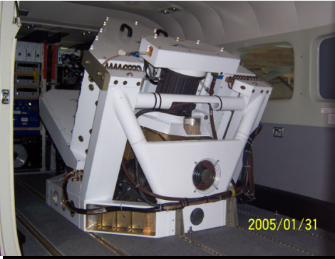
Physics and Engineers
Physics is the understanding that makes engineering design more efficient and, in some instances, possible.
  Example: Tacoma Narrows Bridge
  Personal Example: ITT ANGEL system wavelength design
Often, in my experience, an understanding of physics makes the difference that allows promotion within a discipline or advancement to system level engineering

Slide 20
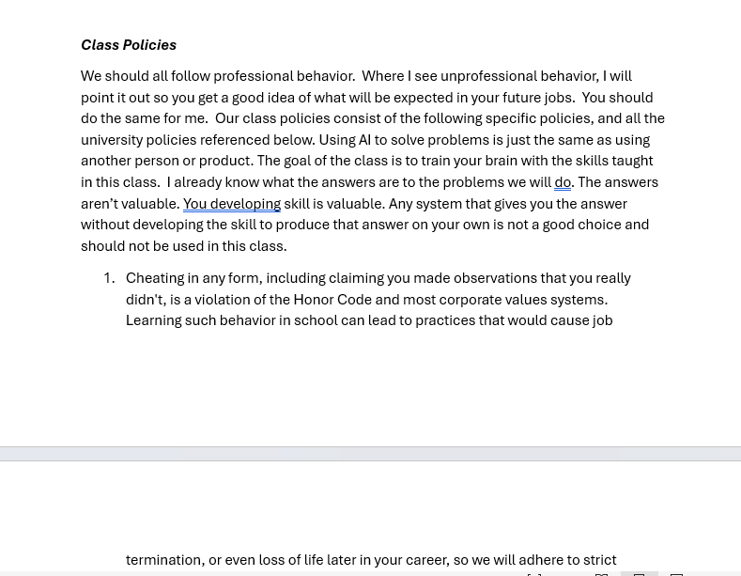
Class Policies
Read the Syllabus

Slide 21
Procedures
Time in Class and Content: We will spend 60 minutes each day in class. Three days a week (MWF) will be lecture days. The other two are called “recitation days.” We will use at least one of these to do homework problems as groups. The homework load is quite substantial for this course because we will do many of the problems together. It is not a winning strategy to skip the homework days and try to do all the problems on your own. The course is not designed for this approach. I will also schedule special homework on Tuesdays and Thursdays that will require you to perform some measurements. On Tuesdays and Thursdays we will also reserve time for your presentations (see below).
We will not normally cover all the material in the chapter (derivations, example problems, etc.) You should come prepared to discuss this material. By “prepared” I mean that you should read the chapter sections assigned in the book before class starts. This is hard and takes some getting used to.

Slide 22
Procedures
Class attendance: It is very important that you attend class if you expect to keep up with assignments, examination preparation, etc. You will not see me taking roll, but I will always know from the clicker system if you are not attending class. I tend to “give the benefit of the doubt” (in terms of exam grading and final grades) to those students who faithfully attend class. If you must miss class for an interview or other BYU-I approved activity, please let me know in advance. You will be responsible for all information given as announcements in class whether you are there or not, so if you must miss, talk to me or to a trusted colleague to find out what happened in class.

Slide 23
Grading (1 of 2)
Grade Item | Percent of Final Grade
Tutorials | 15
Exam Prep Assignments | 20
Pretest | 2
Exam 1 | 12
Exam 2 | 12
Exam 3 | 12
Exam 4 | 12
Exam 5 | 12
Final | 3
Notes:
Final will be comprehensive
The third test is to not make the final so long

Slide 24
Grading (2 of 2)
There is no pre-assigned quota of A’s and C’s that will be given in the class. My personal goal is to give each of you all you need to earn an A. But it would not be beneficial to you if I artificially gave high grades. Level of effort and understanding of course material are two important factors to me in assigning letter grades.
93-100 | A |  | 73-77 | C
90-94 | A- |  | 70-73 | C-
87-90 | B+ |  | 67-70 | D+
83-87 | B |  | 63-67 | D
80-83 | B- |  | 60-63 | D-
77-80 | C+ |  | 0-60 | F
Letter grades will be assigned to the percentages of the final total score as shown in the table

Slide 25
Exam Prep Assignments
Between 6 and 14 problems (sometimes more, sometimes less) will be assigned from each chapter.
Exam Prep Homework will be due on Tuesdays. I will try to not assign a problem until we have had a chance to talk about the material in class. Because of the holiday schedule, this sometimes makes the problem load uneven from assignment to assignment. You will know in advance what problems are assigned, and should plan time for the larger assignments.
You will not be able to finish the homework assignments in the hour and forty minutes a week of non-lecture time we have on Tuesdays and Thursdays. To make best use of this time, I suggest you look at the problems before the class homework sessions, and come prepared with questions. If you will miss a Tuesday or Thursday class, please let me know in advance.
You will turn in all of the homework problems. Neatness, organization, and use of the homework problem solving process will be part of the grade.

Slide 26
AI and Solution Manuals
Chat GPT can answer our Exam Prep problems. But it can’t take your test and it doesn’t want a grade in this class. Don’t become dependent on AI to do your homework.
To copy a solution from AI or a manual without noting that you have done so is to commit plagiarism. Since this is a violation of the Honor Code, please do not do this.
Consistently using anyone else’s solutions will not prepare you for the exams, and will likely lead to a very poor understanding of the material and an unfortunate grade.
If you are stuck on a problem, then it might be a reasonable use of an AI or online help or a solution manual, but be sure to form your own solution. Consulting a physics tutor or talking to me might be even better.

Slide 27
Examinations
The exam questions will stress problem solving.
A typical exam will consist of ten problems Half of which will be conceptual
As with the homework, the method used is as important as a correct answer.
  Partial credit will be given based on the correctness of the method used.
  The same problem solving process used for homework should be used on the exam questions.
Notes:
I reserve the right to adjust the value of the test to make up for extra hard tests
No extra penalty
I will not adjust the value of the test to make up for extra easy tests
Again, no extra penalty
Student has missed out on a fair assessment of their performance

Slide 28
Teaching Method
Active class
Emphasis on concepts on lecture days
Emphasis on problem solving on homework days
Notes:
If you have trouble with this style of lecture, please let me know
This is in keeping with direction from President Clark

Slide 29
How to be successful in this class
Read the reading assignment
Come to class and participate
Do the practice using the problem solving process (Exam Prep and Tutorial Assignments)
Review for tests (use the review sheets)
Take the tests (and test retakes if necessary)

Slide 30
Question
The professor gave us a list of things to do that have proven to make people more successful in this class.
But they seem to involve a lot of work.
Is there a proven way to be successful in this class and not do all this work?
Yes, you don’t really have to come to class
Yes, you don’t really have to read the book
Yes, you don’t really have to do the homework assignments for practice for the exam
Yes, a), b), and c) are all true
No

Slide 31
Oscillation
(And review of trigonometry)

Slide 32
m
x = 0
x_{max}

Slide 33
Question 123.1.2
You leave class one day, and return the next day. Is this an example of simple harmonic motion?
No, this is periodic motion, but not simple harmonic motion
No, this is not periodic motion, so it cannot be simple harmonic motion
Yes, this is simple harmonic motion because you returned to the same place.
Yes, this is simple harmonic motion because it is periodic.

Slide 34
Question 123.1.3
Is the graph of position vs. time shown an example of simple harmonic motion?
Yes it is
No it is not
Be prepared to defend your case
x
t

Slide 35
Characteristics of SHM
The motion repeats in a regular way, like a grandfather clock pendulum swings back and forth in a set amount of time. This set amount of time is called a period.
The mover object moves about a center position and is symmetric about that position. This center position is the bottom of the swing for our grandfather clock. The idea of symmetry just means that the pendulum reaches the same height on both sides as it swings
The mover object's motion can be traced out in a position vs. time graph. For SHM, the shape of the position vs. time graph is a sinusoid.
The velocity of the mover object constantly changes. It is zero at the extreme points (the points farthest from the center, or the largest positive and the largest negative displacements). That is where it turns around and goes back the other way. It stops there, but just for a split second. The velocity is largest at the equilibrium position (the center position). If we plotted a velocity vs. time graph, the velocity would also be a sinusoid or snake-like shape.
The acceleration also constantly changes. And it is also a sinusoid.

Slide 36
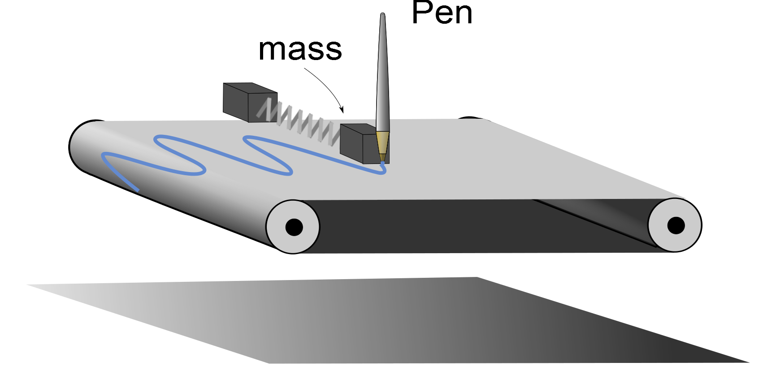

Slide 41
Question 6.8.5
I have an oscillator with a frequency of 440Hz. Which answer below is closest to the period?
a) 400s
b) 0.0025s
c) 220s
d) 800s

Slide 43
Question 123.1.5
Simple Harmonic motion is characterized by a velocity that..
Is constant
Decreasing
Increasing
Constantly changes

Slide 44
Question 6.8
For the graph of simple harmonic motion to the right, what do we call the part of the graph indicated by the blue arrows.
a) Amplitude
b) Frequency
c) Period
d) Phase

Slide 45
Question 6.9
For the graph of simple harmonic motion to the right, what do we call the part of the graph indicated by the green arrows.
a) Amplitude
b) Frequency
c) Period
d) Phase

Slide 49
Question 6.11
I have a mass on a spring undergoing simple harmonic motion. The amplitude is 5m. The frequency is 2Hz. The phase is 0 degrees. When the time is t=2sec, what is the distance the mass will be from the equilibrium point.
5m
-5m
2.5m
0m

Slide 50
Question 123.1.4
The period of a pendulum swing is how long it takes the pendulum bob to go…
All the way from one side to the other side
Half way from one side to the other side
Three quarters’ of the way from one side to the other side
All the way from one side to the other side and back to the starting point.

Slide 51
Question 6.9
For the graph of simple harmonic motion to the right, what do we call the part of the graph indicated by the green arrows.
a) Amplitude
b) Frequency
c) Period
d) Phase

Slide 52
Question 123.1.6
A block on a spring is pulled to position x=x_{max} (called A in the book) and released. In one full cycle of motion, through what total distance does it travel
A/2
A
2A
4A

Slide 53
Question 123.1.7
A mass on a spring in SHM has amplitude A and period T. What is the net displacement of the mass after a time interval T?
0
A/2
A
2A
4A

Slide 54
Question 6.7
Which of the following quantities form sinusoidal patters in a quantity vs. time graph?
Position
Velocity
Acceleration
All of the above

Slide 59
Comparison: SHM Position and Velocity
90° out of phase
x
When x =x_{max}, v=0
When v=v_{max}, x=0
v
T/2
T

Slide 60
a=0
V_{max}
m
x=0
x_{max}
a_{max}
a_{max}
k
V=0
V=0
m
m
-x_{max}
x=0
x_{max}
x=0
a=0
V_{max}
m
x=0
x_{max}

Slide 61
a_{max}
N_{mT}
k
V=0
S_{ms}
m
x=0
x_{max}
W_{mE}

Slide 62
a=0
V_{max}
m
x=0
x_{max}

Slide 63
a_{max}
k
V=0
m
y = 0
x=0
x_{max}

Slide 64
a_{max}
V=0
m
y = 0
-x_{max}
x=0

Slide 67
Question 123.1.9
What does it mean for two oscillators to be “in phase?”
That they have the same position relative to the Sun.
That they rise and fall together
That they both have emotional episodes related to growth in children
I saw this on Star Trek, it means they are in the same place, but you can’t see them

Slide 68
Question 6.10
Compare the graphs of simple harmonic motion to the right the blue curve has a different _______ than the other one
a) Amplitude
b) Frequency
c) Period
d) Phase

Slide 70
Question 6.11
I have a mass on a spring undergoing simple harmonic motion. The amplitude is 5m. The frequency is 2Hz. The phase is 0 degrees. When the time is t=2sec, what is the distance the mass will be from the equilibrium point.
5m
-5m
2.5m
0m

Slide 71
Equilibrium Position
F_{s}
m
x=0
x_{max}
m
x=0
x_{max}
F_{s}
m
-x_{max}
x=0

Slide 72
m
x = 0
x_{max}

Slide 73
v_{i}
m
x = 0
x_{max}

Slide 74
Problem
A particle moving along the x-axis in simple harmonic motion starts from its equilibrium position, the origin, at t=0 and moves to the right. The amplitude of its motion is 2.00cm , and the frequency is 1.50Hz .
  a) show that the position of the particle is given by
  x=(2.00cm )sin(3.00πt)
  determine
  b) the maximum speed and the earliest time (t>0) at which the particle has this speed,
  c) the maximum acceleration and the earliest time (t>0) at which the particle has this acceleration, and
  d) the total distance traveled between t=0 and t=1.00s

Slide 75
End

Slide 76
Misplaced Slides

Slide 77
Question 123.1.11
QQ 15.6 A circular object is in uniform motion. The drawing is at t=0. The projection on the x-axis shown will have what amplitude and phase?
0.50 m and 0
1.00m and 0
0.50m and π
1.00m and π
Can you draw a graph of x vs. t?
0.50m
x

Slide 78
Question 123.1.12
The circular object pictured here is made to rotate clockwise at 29 revolutions per second. It is filmed with a camera that takes 30 frames per second. Compared to its actual motion, the dot on the film appears to move
Clockwise at a very slow rate
Counterclockwise at a very slow rate
Clockwise at a very fast rate
Counterclockwise at a very fast rate
In a random fashion

Slide 79
Trigonometry
ĵ
Remember defining trig functions on a unit circle?
P
y
h
θ
x
î

Slide 80
Trigonometry
ĵ
Suppose we define points along the x-axis (and let the circle have radius h)
P
y
h
θ
-x_{max}
x
x_{max}
î

Slide 81
Dot product
ĵ
We could express the length x as the component of the radius vector or
P
y
r
θ
-x_{max}
x
x_{max}
î

Slide 82
Relationship to SHM
ĵ
The projection of the position of point P on the x axis displays SHM!
P
h
θ
-x_{max}
x
x_{max}
î
SHM along a straight line can be thought of as a projection of a uniform circular motion along a diameter of a reference circle

Slide 83
More Geometry
We can also define points along the y-axis
ĵ
y_{max}
P
y
h
θ
-x_{max}
x
x_{max}
î
-y_{max}

Slide 84
Relationship to SHM
ĵ
This is just two SHOs
One in the x direction
One is the y direction
y_{max}
P
y
h
θ
-x_{max}
x
x_{max}
î
-y_{max}

Slide 85
Equations for the two SHOs
The equation in X is familiar
The projection onto the y-axis is a sine function
An old trig identity says:
What does this say about the phases of the two SHOs?

Slide 86
Rotation and Velocity
Look at the Angular Speed
Then
Let’s take the x-component
ĵ
v_{t}
v_{tx}
θ
y
θ
v_{tx}
î

Slide 87
Rotation and Acceleration
The acceleration of the particle at P is given by
Taking the x- component
ĵ
a_{x}
θ
y
a
θ
a_{x}
î

Slide 88
End of Lecture 1

Slide 89
Question 123.1.10
A mass-spring system is experiencing SHM. At a time, t, it has its maximum value of kinetic energy. At t, its potential energy due to the spring is
Positive
Zero
Negative
Positive but decreasing
Negative but increasing
m
x=0
x_{max}

Slide 90
Pen

Slide 91
Pen

Slide 92
Pen

Slide 96
Old People can do it!

Slide 97
So can you!

